Slide 1
Monopolistic Competition
© 2015 Cengage Learning. All Rights Reserved. May not be copied, scanned, or duplicated, in whole or in part, except for use as permitted in a license distributed with a certain product or service or otherwise on a password-protected website for classroom use.

Slide 2
Monopolistic Competition
Imperfect competition
  Between perfect competition and monopoly
  Oligopoly
  Monopolistic competition
Oligopoly
  Few sellers
  Offer similar or identical products
© 2015 Cengage Learning. All Rights Reserved. May not be copied, scanned, or duplicated, in whole or in part, except for use as permitted in a license distributed with a certain product or service or otherwise on a password-protected website for classroom use.

Slide 3
Monopolistic Competition
Concentration ratio
  Percentage of total output in the market supplied by the four largest firms
Highly-concentrated industries
  Electric lamp bulbs (75%)
  Breakfast cereal (80%)
  Aircraft manufacturing (81%)
  Household laundry equipment (98%)
  Cigarettes (98%)
© 2015 Cengage Learning. All Rights Reserved. May not be copied, scanned, or duplicated, in whole or in part, except for use as permitted in a license distributed with a certain product or service or otherwise on a password-protected website for classroom use.

Slide 4
Monopolistic Competition
Monopolistic competition
  Many sellers
  Product differentiation
    Not price takers
    Downward sloping demand curve
  Free entry and exit
    Zero economic profit in the long run
© 2015 Cengage Learning. All Rights Reserved. May not be copied, scanned, or duplicated, in whole or in part, except for use as permitted in a license distributed with a certain product or service or otherwise on a password-protected website for classroom use.

Slide 5
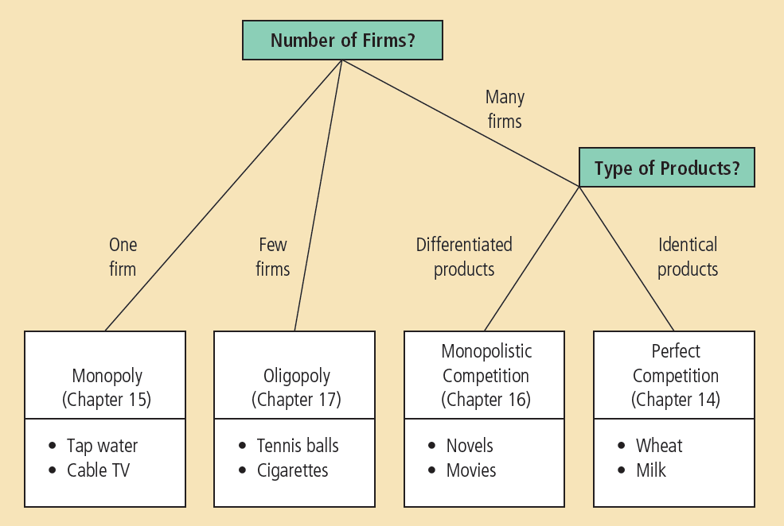
Figure 1
The Four Types of Market Structure
Economists who study industrial organization divide markets into four types—monopoly, oligopoly, monopolistic competition, and perfect competition.
© 2015 Cengage Learning. All Rights Reserved. May not be copied, scanned, or duplicated, in whole or in part, except for use as permitted in a license distributed with a certain product or service or otherwise on a password-protected website for classroom use.

Slide 6
Short Run Equilibrium
Profit maximization
  Produce the quantity where marginal revenue = marginal cost
  Price: on the demand curve
  If P > ATC: profit
  If P < ATC: loss
  Similar to monopoly
© 2015 Cengage Learning. All Rights Reserved. May not be copied, scanned, or duplicated, in whole or in part, except for use as permitted in a license distributed with a certain product or service or otherwise on a password-protected website for classroom use.

Slide 7
Figure 2
Monopolistic Competitors in the Short Run
(a) Firm makes profit
(b) Firm makes losses
Price
Price
MC
MC
ATC
Price
ATC
ATC
ATC
Price
Profit
Demand
Losses
Demand
MR
MR
0
Profit-maximizing
quantity
Quantity
0
Loss-minimizing
quantity
Quantity
Monopolistic competitors, like monopolists, maximize profit by producing the quantity at which marginal revenue equals marginal cost. The firm in panel (a) makes a profit because, at this quantity, price is above average total cost. The firm in panel (b) makes losses because, at this quantity, price is less than average total cost.
© 2015 Cengage Learning. All Rights Reserved. May not be copied, scanned, or duplicated, in whole or in part, except for use as permitted in a license distributed with a certain product or service or otherwise on a password-protected website for classroom use.

Slide 8
Long Run Equilibrium
If firms are making profit in short run
  New firms - incentive to enter the market
  Increase number of products
  Reduces demand faced by each firm
    Demand curve shifts left
  Each firm’s profit declines until: zero economic profit
© 2015 Cengage Learning. All Rights Reserved. May not be copied, scanned, or duplicated, in whole or in part, except for use as permitted in a license distributed with a certain product or service or otherwise on a password-protected website for classroom use.

Slide 9
Figure 3
A Monopolistic Competitor in the Long Run
Price
MC
ATC
Price = ATC
Demand
MR
0
Profit- maximizing
quantity
Quantity
In a monopolistically competitive market, if firms are making profit, new firms enter, and the demand curves for the incumbent firms shift to the left. Similarly, if firms are making losses, some of the firms in the market exit, and the demand curves of the remaining firms shift to the right. Because of these shifts in demand, monopolistically competitive firms eventually find themselves in the long-run equilibrium shown here. In this long-run equilibrium, price equals average total cost, and each firm earns zero profit.
© 2015 Cengage Learning. All Rights Reserved. May not be copied, scanned, or duplicated, in whole or in part, except for use as permitted in a license distributed with a certain product or service or otherwise on a password-protected website for classroom use.

Slide 10
Long Run Equilibrium
Zero economic profit
  Demand curve
    Tangent to average total cost curve
    At quantity where marginal revenue = marginal cost
  Price = average total cost
  Price exceeds marginal cost
© 2015 Cengage Learning. All Rights Reserved. May not be copied, scanned, or duplicated, in whole or in part, except for use as permitted in a license distributed with a certain product or service or otherwise on a password-protected website for classroom use.

Slide 11
Long Run Equilibrium
Monopolistic versus perfect competition
  Monopolistic competition
    Quantity: not at minimum ATC
      Excess capacity
    P > MC, markup over marginal cost
  Perfect competition
    Quantity: at minimum ATC
      Efficient scale
    P = MC
© 2015 Cengage Learning. All Rights Reserved. May not be copied, scanned, or duplicated, in whole or in part, except for use as permitted in a license distributed with a certain product or service or otherwise on a password-protected website for classroom use.

Slide 12
Figure 4
Monopolistic versus Perfect Competition
(a) Monopolistically Competitive Firm
(b) Perfectly Competitive Firm
Price
Price
MC
MC
ATC
Price
ATC
P=MC
P=MR
(demand curve)
Markup
MC
Demand
MR
0
Quantity
produced
Efficient
scale
Quantity
0
Quantity produced
= Efficient scale
Quantity
Excess capacity
Panel (a) shows the long-run equilibrium in a monopolistically competitive market, and panel (b) shows the long-run equilibrium in a perfectly competitive market. Two differences are notable. (1) The perfectly competitive firm produces at the efficient scale, where average total cost is minimized. By contrast, the monopolistically competitive firm produces at less than the efficient scale. (2) Price equals marginal cost under perfect competition, but price is above marginal cost under monopolistic competition.
© 2015 Cengage Learning. All Rights Reserved. May not be copied, scanned, or duplicated, in whole or in part, except for use as permitted in a license distributed with a certain product or service or otherwise on a password-protected website for classroom use.

Slide 13
Welfare of Society
Sources of inefficiency
  Markup of price over marginal cost
    Deadweight loss of monopoly pricing
  Too much or too little entry
    Product-variety externality
      Positive externality on consumers
    Business-stealing externality
      Negative externality on producers
© 2015 Cengage Learning. All Rights Reserved. May not be copied, scanned, or duplicated, in whole or in part, except for use as permitted in a license distributed with a certain product or service or otherwise on a password-protected website for classroom use.

Slide 14
Advertising
Incentive to advertise
  When firms sell differentiated products and charge prices above marginal cost
  Advertise to attract more buyers
Advertising spending
  Highly differentiated goods: 10-20% of revenue
  Industrial products: Little advertising
  Homogenous products: No advertising
© 2015 Cengage Learning. All Rights Reserved. May not be copied, scanned, or duplicated, in whole or in part, except for use as permitted in a license distributed with a certain product or service or otherwise on a password-protected website for classroom use.

Slide 15
Advertising
Debate over advertising
  Wasting resources?
  Valuable purpose?
The critique of advertising
  Firms advertise to manipulate people’s tastes
    Psychological rather than informational
    Creates a desire that otherwise might not exist
© 2015 Cengage Learning. All Rights Reserved. May not be copied, scanned, or duplicated, in whole or in part, except for use as permitted in a license distributed with a certain product or service or otherwise on a password-protected website for classroom use.

Slide 16
Advertising
The critique of advertising
  Impedes competition
  Increase perception of product differentiation
    Foster brand loyalty
  Makes buyers less concerned with price differences among similar goods
© 2015 Cengage Learning. All Rights Reserved. May not be copied, scanned, or duplicated, in whole or in part, except for use as permitted in a license distributed with a certain product or service or otherwise on a password-protected website for classroom use.

Slide 17
Advertising
The defense of advertising
  Provide information to customers
    Customers - make better choices
    Enhances the ability of markets to allocate resources efficiently
  Fosters competition
    Customers - take advantage of price differences
  Allows new firms to enter more easily
© 2015 Cengage Learning. All Rights Reserved. May not be copied, scanned, or duplicated, in whole or in part, except for use as permitted in a license distributed with a certain product or service or otherwise on a password-protected website for classroom use.

Slide 18
Advertising and the price of eyeglasses
What effect does advertising have on the price of a good?
  Consumers – view products as being more different than they otherwise would
    Markets less competitive
    Firms’ demand curves less elastic
    Higher prices
© 2015 Cengage Learning. All Rights Reserved. May not be copied, scanned, or duplicated, in whole or in part, except for use as permitted in a license distributed with a certain product or service or otherwise on a password-protected website for classroom use.

Slide 19
Advertising and the price of eyeglasses
What effect does advertising have on the price of a good?
  Consumers – easier to find firms with the best prices
    Markets – more competitive
    Firms’ demand curves more elastic
    Lower prices
© 2015 Cengage Learning. All Rights Reserved. May not be copied, scanned, or duplicated, in whole or in part, except for use as permitted in a license distributed with a certain product or service or otherwise on a password-protected website for classroom use.

Slide 20
Advertising and the price of eyeglasses
1972, economist Lee Benham
States that prohibited advertising
  Average price = $33 ($248 in 2012 dollars)
States that did not restrict advertising
  Average price = $26 ($196 in 2012 dollars)
Advertising
  Reduced average prices
  Fosters competition
© 2015 Cengage Learning. All Rights Reserved. May not be copied, scanned, or duplicated, in whole or in part, except for use as permitted in a license distributed with a certain product or service or otherwise on a password-protected website for classroom use.

Slide 21

Advertising
Advertising as a signal of quality
  Little apparent information
  Real information offered – a signal
    Willingness to spend large
    amount of money
    = signal about quality of the product
  Content of advertising = irrelevant
Is it rational for consumers to be impressed that Ellen DeGeneres is endorsing this product?
© 2015 Cengage Learning. All Rights Reserved. May not be copied, scanned, or duplicated, in whole or in part, except for use as permitted in a license distributed with a certain product or service or otherwise on a password-protected website for classroom use.

Slide 22
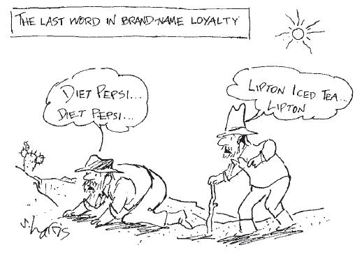
Advertising
Brand names
  Spend more on advertising and charge higher prices than generic substitutes
© 2015 Cengage Learning. All Rights Reserved. May not be copied, scanned, or duplicated, in whole or in part, except for use as permitted in a license distributed with a certain product or service or otherwise on a password-protected website for classroom use.

Slide 23
Advertising
Critics of brand names
  Products – not differentiated
  Irrationality: consumers are willing to pay more for brand names
Defenders of brand names
  Consumers – information about quality
  Firms – incentive to maintain high quality
© 2015 Cengage Learning. All Rights Reserved. May not be copied, scanned, or duplicated, in whole or in part, except for use as permitted in a license distributed with a certain product or service or otherwise on a password-protected website for classroom use.

Slide 24
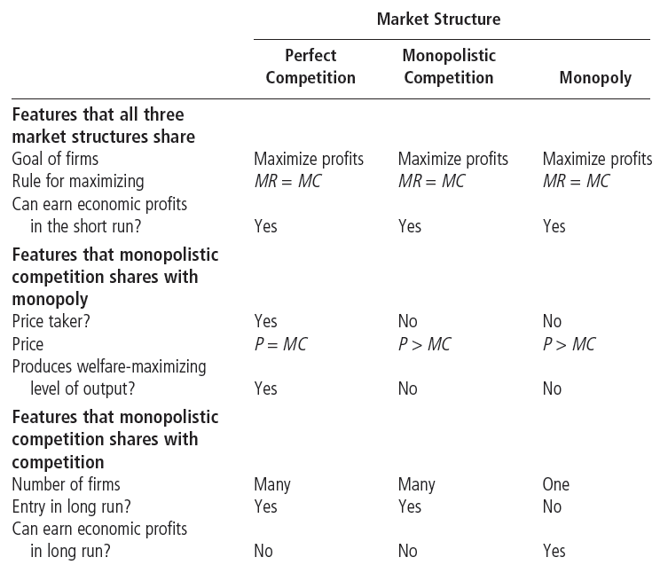
Table 1
Monopolistic Competition: Between Perfect Competition and Monopoly
© 2015 Cengage Learning. All Rights Reserved. May not be copied, scanned, or duplicated, in whole or in part, except for use as permitted in a license distributed with a certain product or service or otherwise on a password-protected website for classroom use.

